Slide 1
Peeking Inside the Box: Observability for Serverless with Cloud Run
Dishant • EPAM Systems • 19 Apr, 2025
Notes:
Welcome and thank you for joining! Today we’re going to demystify observability in serverless environments—especially with Cloud Run. If serverless feels like a black box, we’re going to learn how to shine a light inside.

Slide 2
The Premise
Serverless ≠ Invisible
Serverless simplifies deployment…
…but observability gets trickier.
We want to 'peek inside the box' without giving up the benefits.
Notes:
Serverless gives us power and simplicity. But it comes at a cost—less visibility. We’ll explore how to regain that control with modern tools and a little strategy.

Slide 3
What Is Cloud Run?
Fully managed container platform
Scales to zero
Pay-per-use
Supports any language, any binary
Perfect for microservices, APIs, background jobs
Notes:
Quick refresher: Cloud Run lets you run stateless containers without managing servers. It’s super flexible, and that makes it perfect for microservice-style workloads.

Slide 4
Observability = Metrics + Logs + Traces
Metrics – What is happening?
Logs – Why did it happen?
Traces – Where did it happen?
These pillars give you visibility into serverless workloads.
Notes:
When we say “observability,” we’re talking about more than just logs. It’s the trio: metrics, logs, and traces. Each offers a different view into how your system behaves.

Slide 5
Challenges with Observability in Serverless
No long-running VMs
Ephemeral containers
Harder to use traditional agents
Cold starts, concurrency confusion
Notes:
Serverless changes the game. You don’t have access to the host, so traditional tools like DaemonSets or sidecars aren’t options. We need new patterns.

Slide 6
Observability in Cloud Run – Out of the Box
Built-in support for:
- Cloud Logging (structured + request logs)
- Cloud Monitoring (CPU, memory, latency)
- Cloud Trace
- Cloud Profiler (for some languages)
No agents needed!
Notes:
Here’s the good news—Google Cloud has your back. Cloud Run works natively with all GCP observability tools. You just deploy your code, and you’re already instrumented.

Slide 7
Metrics Deep Dive
Golden Signals
Container restarts
Concurrency and CPU usage
Can visualize in Cloud Monitoring dashboards
Notes:
You get a rich set of metrics out of the box. Not just infra, but request-level data you can use to build alerts or dashboards.

Slide 8
Logging Deep Dive
Stdout/stderr becomes structured logs
Labels: service name, revision, trace ID
Grouped with request logs automatically
Export to BigQuery / PubSub / external tools
Notes:
Cloud Run captures your app’s stdout/stderr and turns it into structured logs. These logs are automatically enriched with metadata like trace IDs, making debugging way easier.

Slide 9
Tracing with Cloud Run
Distributed tracing via Cloud Trace
Supports OpenTelemetry SDKs
Built-in integration with HTTP requests
Trace propagation across services
Notes:
Tracing is where you really start to see the power. Cloud Run supports tracing out of the box, and you can expand it further using OpenTelemetry.

Slide 10
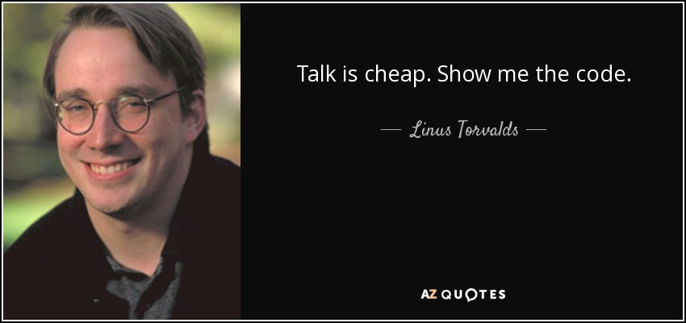
Notes:
(Demo time!) I’ll simulate some traffic and walk through how observability helps pinpoint issues in real time.

Slide 11
Advanced: OpenTelemetry & Custom Metrics
Use OpenTelemetry SDK for custom spans
Emit custom metrics via Cloud Monitoring API
Great for business metrics or fine-tuned tracing
Notes:
Out-of-the-box is great, but custom metrics take it further. Track user signups, queue lengths, or business KPIs. OpenTelemetry makes it flexible.

Slide 12
Tools & Ecosystem
Cloud Run
Cloud Logging / Monitoring / Trace / Profiler
OpenTelemetry
Third-party integrations: Datadog, New Relic, Grafana, etc.
Notes:
Here’s a quick summary of the ecosystem. Whether you stay within GCP or bring your favorite tools, Cloud Run plays well with others.

Slide 13
Best Practices
Always correlate logs and traces with request IDs
Don’t over-log – structured logs > printf
Tag logs with environment, revision
Alert on symptoms, not noise
Notes:
Some golden rules: structured logs, request ID tracing, and alert tuning. These will save you headaches and false alarms.

Slide 14
TL;DR
Serverless isn’t a black box
Cloud Run + GCP tools = powerful observability
Instrument early, trace often, log smart
Notes:
To wrap up: Observability isn’t just a luxury in serverless—it’s essential. And with Cloud Run, you’re already halfway there.

Slide 15
Thank you :)
Notes:
Thanks so much! I’d love to hear your questions or experiences—whether you’re just getting started or deep into distributed tracing.

